Slide 1
Detecting Bugs In Binaries Using Decompilation and Data Flow Analysis
Silvio Cesare <silvio.cesare@gmail.com>

Slide 2
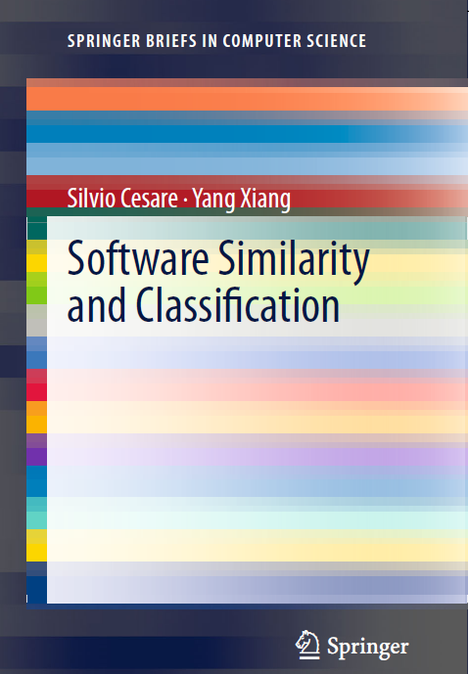
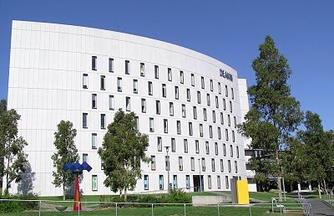
Who am I and where did this talk come from?
Ph.D. Student at Deakin University
Book Author
This talk covers some of my Ph.D. research.

Slide 3
Introduction
Detecting bugs in binary is useful
Black-box penetration testing
External audits and compliance
Verification of compilation and linkage
Quality assurance of 3rd party software

Slide 4
Innovation in this work
Performing static analysis on binaries by:
Using decompilation
And using data flow analysis on the high level results
The novelty is in combining decompilation and traditional static analysis techniques

Slide 5
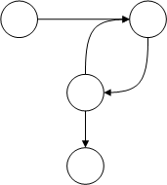
Formal Methods of Program Analysis
Theorem Proving →
Abstract Interpretation →
Model Checking →

Slide 6
Outline
Decompilation
Data Flow Analysis
IL Optimisation
Bug Detection
Bugwise
Future Work and Conclusion

Slide 7
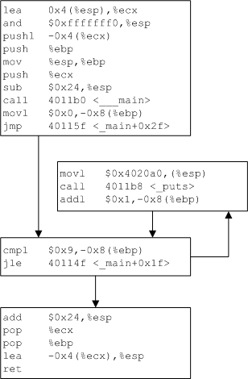
Terminology (1)
Control Flow Graphs represents control flow within a procedure
Intraprocedural analysis works on a single procedure.
Flow sensitive analyses take control flow into account
Pointer analyses can be flow insensitive

Slide 8
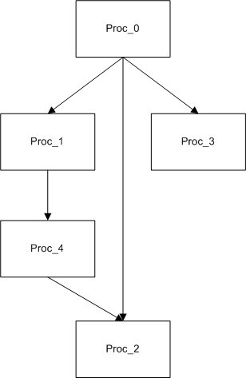
Terminology (2)
Call Graphs represents control flow between procedures
Interprocedural analysis looks at all procedures in a module at once
Context sensitive analyses take into account call stacks
Proc_0
Proc_1
Proc_4
Proc_2
Proc_0
Proc_2
Proc_0
Proc_3

Slide 9
Decompilation

Slide 10
Decompilation overview
Recovers source-level information from a binary
Approach
Representing x86 with an intermediate language (IL)
Inferring stack pointers
Decompiling locals and procedure arguments

Slide 11
Wire – An Formal Language for Binary Analysis
x86 is complex and big
Wire is a low level RISC assembly style language
Translated from x86
Formally defined operational semantics
The LOAD instruction implements a memory read.

Slide 12
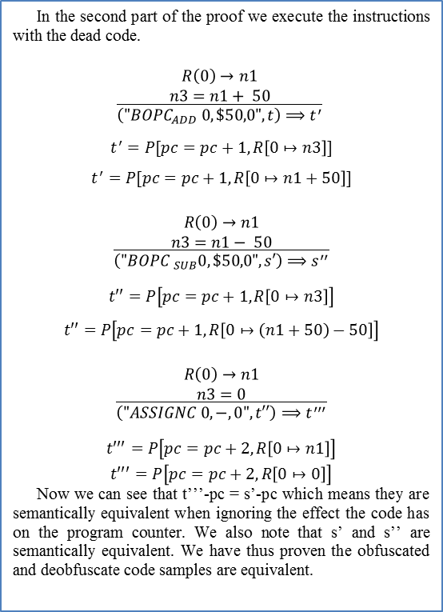
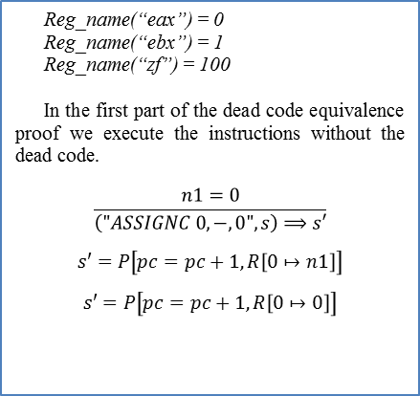
Wire – Equivalence of Dead Code Insertion Obfuscation

Slide 13
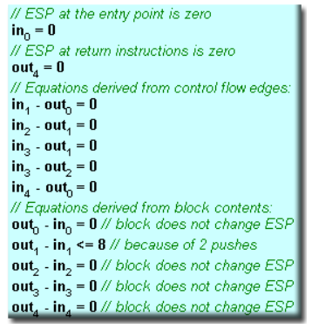
Stack Pointer Inference
Proposed in HexRays decompiler - http://www.hexblog.com/?p=42
Estimate Stack Pointer (SP) in and out of basic block
By tracking and estimating SP modifications using linear equalities
Solve.
Picture from HexRays blog.

Slide 14
Local Variable Recovery
Based on stack pointer inference
Access to memory offset to the stack
Replace with native Wire register
Imark ($0x80483f5, , )
AddImm32 (%esp(4), $0x1c, %temp_memreg(12c))
LoadMem32 (%temp_memreg(12c), , %temp_op1d(66))
Imark ($0x80483f9, , )
StoreMem32(%temp_op1d(66), , %esp(4))
Imark ($0x80483fc, , )
SubImm32 (%esp(4), $0x4, %esp(4))
LoadImm32 ($0x80483fc, , %temp_op1d(66))
StoreMem32(%temp_op1d(66), , %esp(4))
Lcall (, , $0x80482f0)
Imark ($0x80483f5, , )
Imark ($0x80483f9, , )
Imark ($0x80483fc, , )
Free (%local_28(186bc), , )
→

Slide 15
Procedure Parameter and Argument Recovery
Based on stack pointer inference
Offset relative to ESP/EBP indicates local or argument
Arguments also live registers on procedure entry
Free (%local_28(186bc), , )
Imark ($0x8048401, , )
Imark ($0x8048405, , )
Imark ($0x8048408, , )
PushArg32 ($0x0, %local_28(186bc), )
Args (, , )
Call (, , *0x30)

Slide 16
Data Flow Analysis

Slide 17
Data Flow Analysis overview
Data Flow Analysis (DFA) reasons about data
DFA is conservative
It over-approximates
But should not under-approximate
DFA is what an optimising compiler uses
Analyses
Reaching Definitions
Upwards Exposed Uses
Live Variables
Reaching Copies
etc

Slide 18
Monotone Frameworks
Models many data flow problems
Sets of data entering (in) and leaving (out) of basic blocks
Set up equations (forwards analysis)
Data entering or leaving basic block is initialised
Transfer function performs action on data in a basic block
Join operator combines predecessors in control flow graph

Slide 19
Reaching Definitions Example
A reaching definition is a definition of a variable that reaches a program point without being redefined.

Slide 20
A Framework for Data Flow Analysis
Forwards and backwards analysis
Initialise in, out, gen, kill sets for each BB.
Transfer function (forward analysis) is defined as:
Join operator is Union or Intersection.

Slide 21
Reaching Definitions
Gen and Kill sets
gen[B] = { definitions that appear in B and reach the end of B}
kill[B] = { all definitions that never reach the end of B}
Initialisation
out[B] = gen[B]
Confluence Operator
Join = Union
in[B] = U out[P] for predecessors P of B

Slide 22
Upward Exposed Uses
The uses of a definition
Gen and Kill sets
gen[B] = { (s,x) | s is a use of x in B and there is no definition of x between the beginning of B and s}
kill[B] = { (s,x) | s is a use of x not in B and B contains a definition of x}
Initialisation
in[B] = {0}
Confluence Operator
Join = Union
out[B] = U in[S] for successors S of B

Slide 23
More Data Flow Problems
Live Variables
A variable is live if it will be subsequently read without being redefined.
Reaching Copies
The reach of a copy statement
More DFA analyses used in optimising compilers
Available expressions
Very busy expressions
etc

Slide 24
An Iterative Solution
Initialise
Apply transfer function and join.
Iterate over all nodes in the control flow graph
Stop when the nodes’ data stabilise
A “Fixed Point”

Slide 25
A Logic-based Solution
Data flow can be analysed using logic
Datalog is a syntactic subset of prolog
Represent analyses and solve
Reach(d,x,j):- Reach(d,x,i),
StatementAt(i,s),
!Assigns(s,x),
Follows(i,j).
Reach(s,x,j):- StatementAt(i,s),
Assigns(s,x),
Follows(i,j).

Slide 26
Interprocedural Analysis
Dataflow analysis works on the intraprocedural CFG
So.. Make an interprocedural CFG (ICFG)
Replace Calls with branches
Replace Returns with branches back to callsite
Apply monotone analysis

Slide 27
IL Optimisation

Slide 28
IL Optimisation overview
Required to perform other analyses
Decompilation
Bug Detection
Reduces the size of IL code
Optimisations based on data flow analysis
Constant Folding and Propagation
Copy Propagation
Backwards Copy Propagation
Dead Code Elimination
etc

Slide 29
Constant Folding
Motivation - replace x=5 + 5 with x=10
For each arithmetic operator
If the reaching definition of each operand is a single constant assignment
Fold constants in instruction

Slide 30
Constant Propagation
Motivation – reduce number of assignments
If all the reaching definitions of a variable have the same assignment and it is constant:
The constant can be propagated to the variable
x=34
r=x+y
Print(r)
r=34+y
Print(r)
→

Slide 31
Copy Propagation
Motivation – reduce number of copies
For a statement u where x is being used:
Statement s is the only definition of x reaching u
On every path from s to u there are no assignments to y.
Or.. At each use of x where x=y is a reaching copy, replace x with y.
y=x
z=2
r=y+z
Print(r)
z=2
r=x+z
Print(r)
→

Slide 32
Backwards Copy Propagation
Motivation – reduce number of copies
In Bugwise, both forwards and backwards copy propagation are required.
x=34
y=4
r1=x+y
r2=r1
x=34
y=4
r2=x+y
→

Slide 33
Dead Code Elimination
Motivation – reduce number of instructions
For any definition of a variable:
If the variable is not live, then eliminate the instruction.
x=34 (x is not live)
x=10
Print(x)
x=10
Print(x)
→

Slide 34
Bug Detection

Slide 35
Bug detection overview
Decompilation
Transforms locals to native IL variables
Data Flow Analysis
Reasons about IL variables
When variables are used and defined
Bug Detection
getenv()
Use-after-free
Double free

Slide 36
getenv()
Detect unsafe applications of getenv()
Example: strcpy(buf,getenv(“HOME”))
For each getenv()
If return value is live
And it’s the reaching definition to the 2nd argument to strcpy()/strcat()
Then warn
P.S. 2001 wants its bugs back.

Slide 37
Use-after-free
For each free(ptr)
If ptr is live
Then warn
void f(int x)
{
int *p = malloc(10);
dowork(p);
free(p);
if (x)
p[0] = 1;
}

Slide 38
Double free
For each free(ptr)
If an upward exposed use of ptr’s definition is free(ptr)
Then warn
2001 calls again
void f(int x)
{
int *p = malloc(10);
dowork(p);
free(p);
if (x)
free(p);
}

Slide 39
Bugwise

Slide 40
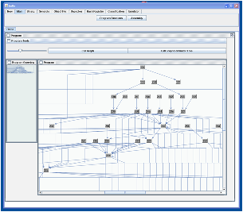
Implementation
Built on my previous Malwise system
Malwise is over 100,000 LOC C++
Bugwise is a set of loadable modules
Everything in this talk and more is implemented

Slide 41
getenv() bugs results
Scanned entire Debian 7 unstable repository
~123,000 ELF binaries
30,450 not scanned.
85 bug reports
47 packages reported
4digits | ptop
acedb-other-belvu | recordmydesktop
acedb-other-dotter | rlplot
bvi | sapphire
comgt | sc
csmash | scm
elvis-tiny | sgrep
fvwm | slurm-llnl-slurmdbd
garmin-ant-downloader | statserial
gcin | stopmotion
gexec | supertransball2
gmorgan | theorur
gopher | twpsk
gsoko | udo
gstm | vnc4server
hime | wily
le-dico-de-rene-cougnenc | wmpinboard
libreoffice-dev | wmppp.app
libxgks-dev | xboing
lie | xemacs21-bin
lpe | xjdic
mp3rename | xmotd
mpich-mpd-bin
open-cobol
procmail

Slide 42
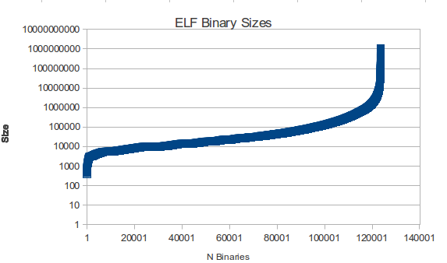
ELF Binary Sizes
Linear growth with logarithmic scaling plus outliers

Slide 43
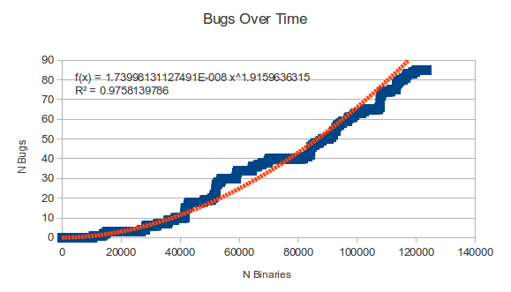
Cumulative getenv() bugs over time - sorted by binary size
Linear or power growth?

Slide 44
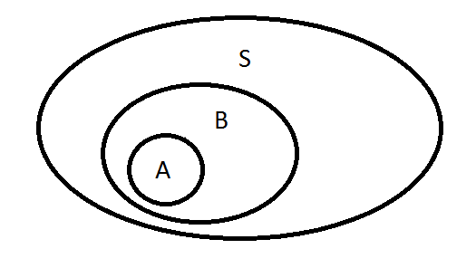
getenv() bug statistics
Probability (P) of a binary being vulnerable: 0.00067
P. of a package being vulnerable: 0.00255
P. of a package having a 2nd vulnerability given that one binary in the package is vulnerable: 0.52380
Conditional probability of A given that B has occurred:

Slide 45
Double free SGID games “xonix” in Debian 6
memset(score_rec[i].login, 0, 11);
strncpy(score_rec[i].login, pw->pw_name, 10);
memset(score_rec[i].full, 0, 65);
strncpy(score_rec[i].full, fullname, 64);
score_rec[i].tstamp = time(NULL);
free(fullname);
if((high = freopen(PATH_HIGHSCORE, "w",high)) == NULL) {
fprintf(stderr, "xonix: cannot reopen high score file\n");
free(fullname);
gameover_pending = 0;
return;
}

Slide 46
Future work and conclusion

Slide 47
Future Work
Core
Summary-based interprocedural analysis
Context sensitive interprocedural analysis
Pointer analysis
Improved decompilation
Bug Detection
Uninitialised variables
Unchecked return values
More evaluation and results

Slide 48
Conclusion
Traditional static analysis can find bugs.
Decompilation bridges the binary gap.
Bugwise works on real Linux binaries.
It is available to use.
http://www.FooCodeChu.com

